Slide 1
UNIVERSITY OF ENGINEERING & MANAGEMENT,JAIPUR
NAME: NISTHA BHURA
ENROLLMENT NO.: 12022002026043
COURSE: BTECH
BRANCH: CSE(AIML)
YEAR: 1ST YEAR
SEMESTER: 2ND SEMESTER
SUBJECT: CHEMISTRY PRACTICAL
TOPIC: PREPARATION OF A POLYMER

Slide 2
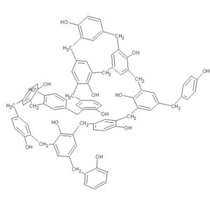
N
NAME: PHENOL FORMALDEHYDE (P-F) RESIN
STRUCTURE:

Slide 3
PROCEDURE:
Take a 100ml beaker and pour 5ml of glacial acetic acid , 2.5ml of 40% aqueous formaldehyde and 2 grams of phenol safely.
Take a wet cloth and wrap the beaker. You can also place the beaker in a 250 ml beaker having a small amount of water in it.
Add concentrated HCl dropwise with vigorous stirring using a glass rod till the appearance of a pink coloured gummy mass.
Wash the pink residue number of times to wash away the acid and make it free from acid.
Filter the product and weigh it after drying in folds of a filter or an oven

Slide 4
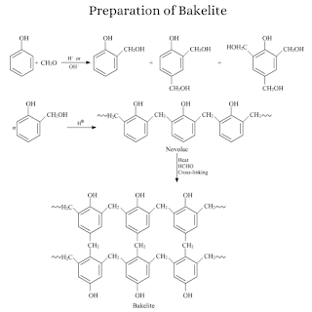
SYNTHESIS:

Slide 5
APPLICATIONS:
1.In-Circuit Board Preparation:
Phenolic resins are primarily used for making circuit boards like PCB.
Further, we find the applications of phenolic resins in Electrical equipment.
2. Day-to-Day Applications:
Also, it is needed in the following areas:
Caps
Handles
Buttons
Radio cabinets
Furniture
Knobs
Vacuum cleaner
Cameras
Ashtrays
Engine ignition equipment

Slide 6
CONCLUSION:
COLOUR: PINK
WEIGHT: 28.5 g
TYPE: CONDENSATION & THERMOSETTING POLYMER
SURFACE: SMOOTH & LUSTROUS SURFACE
STABILTY: HARD & RIGID WITH GOOD DIMENSIONAL STABILITY
STRENGTH: LOW IMPACT STRENGTH
MOLDING EFFICIENCY: EASY TO MOLD
ELECTRICAL PROPERTY: GOOD ELECTRICAL INSULATORS
TYPE OF PLASTIC: LAMINATED PLASTIC

Slide 7
THANK YOU!

